Slide 1
CLIENT ADDICTION TO AUTOMATION - HOW TO
Jehu Omoruku

Slide 2
CLIENT ADDICTION TO AUTOMATION - HOW TO
JEHU OMORUKU

Slide 3
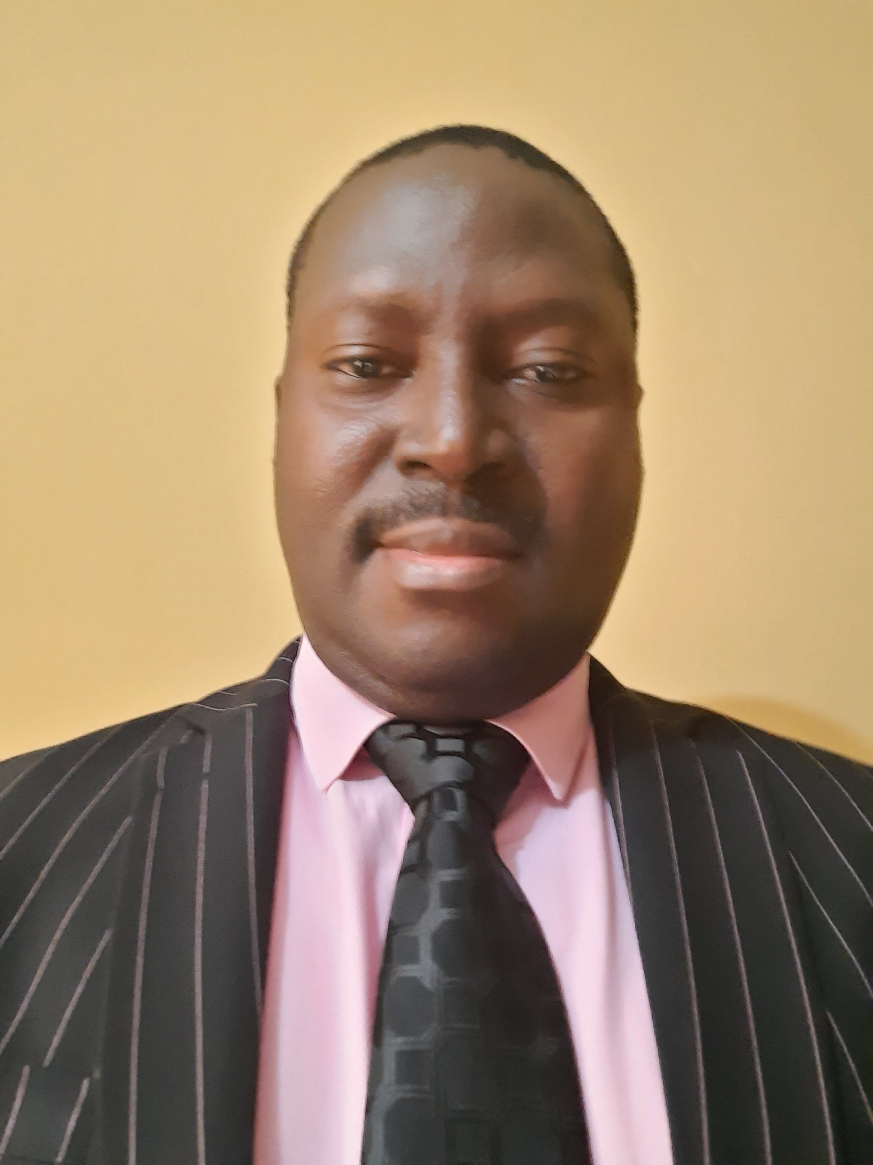

About The Speaker
Entrepreneur
CEO and Co-Founder
GoldTouch Technologies Ltd
SharePoint Expert
Over 15 years of technical and Managerial experience
GoldTouch is a Tech company that specializes in SharePoint, Automation and array of tech platforms development.
Groups: Power Platform User Group, SharePoint Saturday

Slide 4
Audience Sector And Clients
AUDIENCE SECTOR
IT Consulting Firms
Banking or Insurance IT Department
Telco IT Department
Oil and Gas IT Department
CLIENTS
External Clients
Internal Clients

Slide 5
Session Objective
To remain in business if you are an independent consultant
To be relevant as a Power Platform Specialist / Developer
To remain employed if you work in the IT department of the sectors mentioned in the previous slide
To retain your clients as well as buy again
To increase your clients portfolio

Slide 6
Agenda - How To Make The Client Addicted To Automation
The Right Attitude
Skills
Quality Work
Customer Focus
Customer Satisfaction

Slide 7
Right Attitude
To get your client and customers addicted to automation, you must have the right attitude. The right attitude would make you…
Arrive at scheduled meetings on time
Not getting mad at the client when he is not happy with you or your work
Admitting your mistakes
Taking responsibility for your actions
Apologizing when at fault
Been Polite and courteous
Looking Good to site and well dressed

Slide 8
Skills
Business Processes Automation based on Microsoft platform using either Power Automate, Power Apps, Power BI and SharePoint requires grounded and excellent skills in the following areas;
Analytical Skills (Been able to translate users or business requirements)
Deep Skills in The Power Platform itself with no code (Power Automate, Power Apps and Power BI).
Deep Coding Skills in SharePoint with :
JavaScript (JSON) for SharePoint Online
On-Premise, C#(CSOM) to write farm solutions for On-Premise or Azure hosted SharePoint farms (Although you don’t need coding skills to excel in Power Platform)

Slide 9
Quality Work
For you to get your client to be addicted to automation, you must not compromise on quality. The following needs to be done to achieve top quality work.
Plan
Determine your approach, architectural design
Proper Documentation
Document requirements and processes
Track, update and document changes to business processes
You must develop bug free business processes or applications
Quality Assurance and Testing
You need to test properly before handling over to the client
Review Code to fish out bugs (for code based automation)
Code Documentation for maintenance and continuity

Slide 10
Customer Focus
For you to get your clients addicted to automation which will in turn enable you to remain in the Power Automation Business, you must develop and imbibe Client or Customer Focus.
Follow up: Follow up on clients requests or complaints related to your automated processes.
Use Clear Language: Be exact in your words e.g I will fix the issue by 12noon, not political language, e.g. “very soon”.
Anticipate hidden needs or requirements your clients aren't yet aware of. Use your knowledge and experience to be on the lookout for opportunities to share proactive service.
Use the Pre-Emptive Acknowledgement
Take the Thank You Letter Challenge
Take Action!

Slide 11
Client Satisfaction
For you to get your client addicted to automation which will in turn enable you to remain in the Power Automation Business, you must satisfy your client on every project.
Speed is critical: Customers expect a 24 hour response time. They are delighted when they hear from you within 6 hours and amazed by a 1 hour response. The faster you respond to your Clients the easier it becomes to close a new deal or solve a problem. Failure to return a call or email is inexcusable.
Never so “No” or “Impossible”: If you don’t have an immediate answer, quickly inform the customer that you are working on their inquiry and will get back to them soon. Then do it!
Keep measuring your Client satisfaction

Slide 12
Client Satisfaction
I (We) will fix the issue / bug: When responding to a client complaint or a bug, always begin by assuring the Client that you will fix their problem. This immediately removes the adversarial relationship that can lead to messy and expensive confrontations.
Treat every Client as if they were a VIP
Make a real effort to help your customers and assist them in every way you can in their work.
Keep your promises and integrity. If you say that you will contact them to let them know of a request– be sure that you do! Every so often, businesses forget or fail to get back to their customers, who might very well find another supplier or consultant in the meantime.
Thank your customers for their business, both in person and also printed on the receipt.

Slide 13
Conclusion
GETTING YOUR CLIENT ADDICTED TO AUTOMATION KEEPS YOU IN BUSINESS OR JOB.

Slide 14
Any Questions?

Slide 15
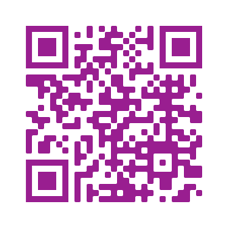
Please fill out the survey! & Win Swags!!
https://www.powerplatformbootcamp.com/survey

Slide 16
Thank You For Attending

